Slide 1
Data Structure and Algorithm Using Java

Slide 2
Table of Content
  AIM
* Classification of Sorting Methods,
* Bubble Sort,
* Selection Sort,
* Insertion Sort,
* Quick Sort,
* Merge Sort,
* Heap Sort
* Radix Sort,
* Classification of Searching,
* Linear Search, Binary Search,
* Hashing Functions – Division Reminder, Mid Square Method, Folding Method;
* Collision Resolution Techniques.
* String search and matching.

Slide 3
CHAPTER 4
Sorting and Searching

Slide 4
Sorting
Sorting takes an unordered collection and makes it an ordered one.
1 2 3 4 5 6
77
42
35
12
101
5
1 2 3 4 5 6
5
12
35
42
77
101

Slide 5
Selection Sort
5 | 1 | 3 | 4 | 6 | 2
Comparison
Data Movement
Sorted

Slide 6
Selection Sort
5 | 1 | 3 | 4 | 6 | 2
Comparison
Data Movement
Sorted

Slide 7
Selection Sort
5 | 1 | 3 | 4 | 6 | 2
Comparison
Data Movement
Sorted

Slide 8
Selection Sort
5 | 1 | 3 | 4 | 6 | 2
Comparison
Data Movement
Sorted

Slide 9
Selection Sort
5 | 1 | 3 | 4 | 6 | 2
Comparison
Data Movement
Sorted

Slide 10
Selection Sort
5 | 1 | 3 | 4 | 6 | 2
Comparison
Data Movement
Sorted

Slide 11
Selection Sort
5 | 1 | 3 | 4 | 6 | 2
Comparison
Data Movement
Sorted

Slide 12
Selection Sort
5 | 1 | 3 | 4 | 6 | 2
•
Largest
Comparison
Data Movement
Sorted

Slide 13
Selection Sort
5 | 1 | 3 | 4 | 2 | 6
Comparison
Data Movement
Sorted

Slide 14
Selection Sort
5 | 1 | 3 | 4 | 2 | 6
Comparison
Data Movement
Sorted

Slide 15
Selection Sort
5 | 1 | 3 | 4 | 2 | 6
Comparison
Data Movement
Sorted

Slide 16
Selection Sort
5 | 1 | 3 | 4 | 2 | 6
Comparison
Data Movement
Sorted

Slide 17
Selection Sort
5 | 1 | 3 | 4 | 2 | 6
Comparison
Data Movement
Sorted

Slide 18
Selection Sort
5 | 1 | 3 | 4 | 2 | 6
Comparison
Data Movement
Sorted

Slide 19
Selection Sort
5 | 1 | 3 | 4 | 2 | 6
Comparison
Data Movement
Sorted

Slide 20
Selection Sort
5 | 1 | 3 | 4 | 2 | 6
•
Largest
Comparison
Data Movement
Sorted

Slide 21
Selection Sort
2 | 1 | 3 | 4 | 5 | 6
Comparison
Data Movement
Sorted

Slide 22
Selection Sort
2 | 1 | 3 | 4 | 5 | 6
Comparison
Data Movement
Sorted

Slide 23
Selection Sort
2 | 1 | 3 | 4 | 5 | 6
Comparison
Data Movement
Sorted

Slide 24
Selection Sort
2 | 1 | 3 | 4 | 5 | 6
Comparison
Data Movement
Sorted

Slide 25
Selection Sort
2 | 1 | 3 | 4 | 5 | 6
Comparison
Data Movement
Sorted

Slide 26
Selection Sort
2 | 1 | 3 | 4 | 5 | 6
Comparison
Data Movement
Sorted

Slide 27
Selection Sort
2 | 1 | 3 | 4 | 5 | 6
•
Largest
Comparison
Data Movement
Sorted

Slide 28
Selection Sort
2 | 1 | 3 | 4 | 5 | 6
Comparison
Data Movement
Sorted

Slide 29
Selection Sort
2 | 1 | 3 | 4 | 5 | 6
Comparison
Data Movement
Sorted

Slide 30
Selection Sort
2 | 1 | 3 | 4 | 5 | 6
Comparison
Data Movement
Sorted

Slide 31
Selection Sort
2 | 1 | 3 | 4 | 5 | 6
Comparison
Data Movement
Sorted

Slide 32
Selection Sort
2 | 1 | 3 | 4 | 5 | 6
Comparison
Data Movement
Sorted

Slide 33
Selection Sort
2 | 1 | 3 | 4 | 5 | 6
•
Largest
Comparison
Data Movement
Sorted

Slide 34
Selection Sort
2 | 1 | 3 | 4 | 5 | 6
Comparison
Data Movement
Sorted

Slide 35
Selection Sort
2 | 1 | 3 | 4 | 5 | 6
Comparison
Data Movement
Sorted

Slide 36
Selection Sort
2 | 1 | 3 | 4 | 5 | 6
Comparison
Data Movement
Sorted

Slide 37
Selection Sort
2 | 1 | 3 | 4 | 5 | 6
Comparison
Data Movement
Sorted

Slide 38
Selection Sort
2 | 1 | 3 | 4 | 5 | 6
•
Largest
Comparison
Data Movement
Sorted

Slide 39
Selection Sort
1 | 2 | 3 | 4 | 5 | 6
Comparison
Data Movement
Sorted

Slide 40
Selection Sort
1 | 2 | 3 | 4 | 5 | 6
DONE!
Comparison
Data Movement
Sorted

Slide 41
Bubble Sort

Slide 42
"Bubbling Up" the Largest Element
Traverse a collection of elements
  Move from the front to the end
  “Bubble” the largest value to the end using pair-wise comparisons and swapping
1 2 3 4 5 6
77
42
35
12
101
5

Slide 43
"Bubbling Up" the Largest Element
Traverse a collection of elements
  Move from the front to the end
  “Bubble” the largest value to the end using pair-wise comparisons and swapping
Swap
1 2 3 4 5 6
42
77
77
42
35
12
101
5

Slide 44
"Bubbling Up" the Largest Element
Traverse a collection of elements
  Move from the front to the end
  “Bubble” the largest value to the end using pair-wise comparisons and swapping
1 2 3 4 5 6
Swap
35
77
42
77
35
12
101
5

Slide 45
"Bubbling Up" the Largest Element
Traverse a collection of elements
  Move from the front to the end
  “Bubble” the largest value to the end using pair-wise comparisons and swapping
1 2 3 4 5 6
Swap
12
77
42
35
77
12
101
5

Slide 46
"Bubbling Up" the Largest Element
Traverse a collection of elements
  Move from the front to the end
  “Bubble” the largest value to the end using pair-wise comparisons and swapping
1 2 3 4 5 6
42
35
12
77
101
5
No need to swap

Slide 47
"Bubbling Up" the Largest Element
Traverse a collection of elements
  Move from the front to the end
  “Bubble” the largest value to the end using pair-wise comparisons and swapping
1 2 3 4 5 6
Swap
5
101
42
35
12
77
101
5

Slide 48
"Bubbling Up" the Largest Element
Traverse a collection of elements
  Move from the front to the end
  “Bubble” the largest value to the end using pair-wise comparisons and swapping
1 2 3 4 5 6
101
42
35
12
77
5
Largest value correctly placed

Slide 49
The “Bubble Up” Algorithm
index = 0
last_index = n – 1
loop
exitif(index > last_index)
if(A[index] > A[index + 1]) then
Swap(A[index], A[index + 1])
endif
index = index + 1
endloop

Slide 50
No, Swap isn’t built in.
LB
Procedure Swap(a, b isoftype in/out Num)
t isoftype Num
t = a
a = b
b = t
endprocedure // Swap

Slide 51
Items of Interest
Notice that only the largest value is correctly placed
All other values are still out of order
So we need to repeat this process
1 2 3 4 5 6
101
42
35
12
77
5
Largest value correctly placed

Slide 52
Repeat “Bubble Up” How Many Times?
If we have N elements…
And if each time we bubble an element, we place it in its correct location…
Then we repeat the “bubble up” process N – 1 times.
This guarantees we’ll correctly
place all N elements.

Slide 53
“Bubbling” All the Elements
1 2 3 4 5 6
42
35
12
77
5
101
1 2 3 4 5 6
35
12
42
5
77
101
1 2 3 4 5 6
N - 1
12
35
5
42
77
101
1 2 3 4 5 6
12
5
35
42
77
101
1 2 3 4 5 6
5
12
35
42
77
101

Slide 54
Reducing the Number of Comparisons
1 2 3 4 5 6
77
42
35
12
101
5
1 2 3 4 5 6
42
35
12
77
5
101
1 2 3 4 5 6
35
12
42
5
77
101
1 2 3 4 5 6
12
35
5
42
77
101
1 2 3 4 5 6
12
5
35
42
77
101

Slide 55
Reducing the Number of Comparisons
On the N^{th} “bubble up”, we only need to
do MAX-N comparisons.
For example:
  This is the 4th “bubble up”
  MAX is 6
  Thus we have 2 comparisons to do
1 2 3 4 5 6
12
35
5
42
77
101

Slide 56
Putting It All Together

Slide 57
N is … // Size of Array
Arr_Type definesa Array[1..N] of Num
Procedure Swap(n1, n2 isoftype in/out Num)
temp isoftype Num
temp = n1
n1 = n2
n2 = temp
endprocedure // Swap

Slide 58
procedure Bubblesort(A isoftype in/out Arr_Type)
to_do, index isoftype Num
to_do = N – 1
loop
exitif(to_do == 0)
index = 0
loop
exitif(index > to_do)
if(A[index] > A[index + 1]) then
Swap(A[index], A[index + 1])
endif
index = index + 1
endloop
to_do = to_do - 1
endloop
endprocedure // Bubblesort
Inner loop
Outer loop

Slide 59
Already Sorted Collections?
What if the collection was already sorted?
What if only a few elements were out of place and after a couple of “bubble ups,” the collection was sorted?
We want to be able to detect this
and “stop early”!
1 2 3 4 5 6
5
12
35
42
77
101

Slide 60
Using a Boolean “Flag”
We can use a boolean variable to determine if any swapping occurred during the “bubble up.”
If no swapping occurred, then we know that the collection is already sorted!
This boolean “flag” needs to be reset after each “bubble up.”

Slide 61
did_swap isoftype Boolean
did_swap = true
loop
exitif ((to_do == 0) OR NOT(did_swap))
index = 0
did_swap = false
loop
exitif(index > to_do)
if(A[index] > A[index + 1]) then
Swap(A[index], A[index + 1])
did_swap = true
endif
index = index + 1
endloop
to_do = to_do - 1
endloop

Slide 62
An Animated Example
N
8
did_swap
true
to_do
7
index
98
23
45
14
6
67
33
42
1 2 3 4 5 6 7 8

Slide 63
An Animated Example
N
8
did_swap
false
to_do
7
index
1
98
23
45
14
6
67
33
42
1 2 3 4 5 6 7 8

Slide 64
An Animated Example
N
8
did_swap
false
to_do
7
index
1
Swap
98
23
45
14
6
67
33
42
1 2 3 4 5 6 7 8

Slide 65
An Animated Example
N
8
did_swap
true
to_do
7
index
1
Swap
23
98
45
14
6
67
33
42
1 2 3 4 5 6 7 8

Slide 66
An Animated Example
N
8
did_swap
true
to_do
7
index
2
23
98
45
14
6
67
33
42
1 2 3 4 5 6 7 8

Slide 67
An Animated Example
N
8
did_swap
true
to_do
7
index
2
Swap
23
98
45
14
6
67
33
42
1 2 3 4 5 6 7 8

Slide 68
An Animated Example
N
8
did_swap
true
to_do
7
index
2
Swap
23
45
98
14
6
67
33
42
1 2 3 4 5 6 7 8

Slide 69
An Animated Example
N
8
did_swap
true
to_do
7
index
3
23
45
98
14
6
67
33
42
1 2 3 4 5 6 7 8

Slide 70
An Animated Example
N
8
did_swap
true
to_do
7
index
3
Swap
23
45
98
14
6
67
33
42
1 2 3 4 5 6 7 8

Slide 71
An Animated Example
N
8
did_swap
true
to_do
7
index
3
Swap
23
45
14
98
6
67
33
42
1 2 3 4 5 6 7 8

Slide 72
An Animated Example
N
8
did_swap
true
to_do
7
index
4
23
45
14
98
6
67
33
42
1 2 3 4 5 6 7 8

Slide 73
An Animated Example
N
8
did_swap
true
to_do
7
index
4
Swap
23
45
14
98
6
67
33
42
1 2 3 4 5 6 7 8

Slide 74
An Animated Example
N
8
did_swap
true
to_do
7
index
4
Swap
23
45
14
6
98
67
33
42
1 2 3 4 5 6 7 8

Slide 75
An Animated Example
N
8
did_swap
true
to_do
7
index
5
23
45
14
6
98
67
33
42
1 2 3 4 5 6 7 8

Slide 76
An Animated Example
N
8
did_swap
true
to_do
7
index
5
Swap
23
45
14
6
98
67
33
42
1 2 3 4 5 6 7 8

Slide 77
An Animated Example
N
8
did_swap
true
to_do
7
index
5
Swap
23
45
14
6
67
98
33
42
1 2 3 4 5 6 7 8

Slide 78
An Animated Example
N
8
did_swap
true
to_do
7
index
6
23
45
14
6
67
98
33
42
1 2 3 4 5 6 7 8

Slide 79
An Animated Example
N
8
did_swap
true
to_do
7
index
6
Swap
23
45
14
6
67
98
33
42
1 2 3 4 5 6 7 8

Slide 80
An Animated Example
N
8
did_swap
true
to_do
7
index
6
Swap
23
45
14
6
67
33
98
42
1 2 3 4 5 6 7 8

Slide 81
An Animated Example
N
8
did_swap
true
to_do
7
index
7
23
45
14
6
67
33
98
42
1 2 3 4 5 6 7 8

Slide 82
An Animated Example
N
8
did_swap
true
to_do
7
index
7
Swap
23
45
14
6
67
33
98
42
1 2 3 4 5 6 7 8

Slide 83
An Animated Example
N
8
did_swap
true
to_do
7
index
7
Swap
23
45
14
6
67
33
42
98
1 2 3 4 5 6 7 8

Slide 84
After First Pass of Outer Loop
N
8
did_swap
true
to_do
7
index
8
Finished first “Bubble Up”
23
45
14
6
67
33
42
98
1 2 3 4 5 6 7 8

Slide 85
The Second “Bubble Up”
N
8
did_swap
false
to_do
6
index
1
23
45
14
6
67
33
42
98
1 2 3 4 5 6 7 8

Slide 86
The Second “Bubble Up”
N
8
did_swap
false
to_do
6
index
1
No Swap
23
45
14
6
67
33
42
98
1 2 3 4 5 6 7 8

Slide 87
The Second “Bubble Up”
N
8
did_swap
false
to_do
6
index
2
23
45
14
6
67
33
42
98
1 2 3 4 5 6 7 8

Slide 88
The Second “Bubble Up”
N
8
did_swap
false
to_do
6
index
2
Swap
23
45
14
6
67
33
42
98
1 2 3 4 5 6 7 8

Slide 89
The Second “Bubble Up”
N
8
did_swap
true
to_do
6
index
2
Swap
23
14
45
6
67
33
42
98
1 2 3 4 5 6 7 8

Slide 90
The Second “Bubble Up”
N
8
did_swap
true
to_do
6
index
3
23
14
45
6
67
33
42
98
1 2 3 4 5 6 7 8

Slide 91
The Second “Bubble Up”
N
8
did_swap
true
to_do
6
index
3
Swap
23
14
45
6
67
33
42
98
1 2 3 4 5 6 7 8

Slide 92
The Second “Bubble Up”
N
8
did_swap
true
to_do
6
index
3
Swap
23
14
6
45
67
33
42
98
1 2 3 4 5 6 7 8

Slide 93
The Second “Bubble Up”
N
8
did_swap
true
to_do
6
index
4
23
14
6
45
67
33
42
98
1 2 3 4 5 6 7 8

Slide 94
The Second “Bubble Up”
N
8
did_swap
true
to_do
6
index
4
No Swap
23
14
6
45
67
33
42
98
1 2 3 4 5 6 7 8

Slide 95
The Second “Bubble Up”
N
8
did_swap
true
to_do
6
index
5
23
14
6
45
67
33
42
98
1 2 3 4 5 6 7 8

Slide 96
The Second “Bubble Up”
N
8
did_swap
true
to_do
6
index
5
Swap
23
14
6
45
67
33
42
98
1 2 3 4 5 6 7 8

Slide 97
The Second “Bubble Up”
N
8
did_swap
true
to_do
6
index
5
Swap
23
14
6
45
33
67
42
98
1 2 3 4 5 6 7 8

Slide 98
The Second “Bubble Up”
N
8
did_swap
true
to_do
6
index
6
23
14
6
45
33
67
42
98
1 2 3 4 5 6 7 8

Slide 99
The Second “Bubble Up”
N
8
did_swap
true
to_do
6
index
6
Swap
23
14
6
45
33
67
42
98
1 2 3 4 5 6 7 8

Slide 100
The Second “Bubble Up”
N
8
did_swap
true
to_do
6
index
6
Swap
23
14
6
45
33
42
67
98
1 2 3 4 5 6 7 8

Slide 101
After Second Pass of Outer Loop
N
8
did_swap
true
to_do
6
index
7
Finished second “Bubble Up”
23
14
6
45
33
42
67
98
1 2 3 4 5 6 7 8

Slide 102
The Third “Bubble Up”
N
8
did_swap
false
to_do
5
index
1
23
14
6
45
33
42
67
98
1 2 3 4 5 6 7 8

Slide 103
The Third “Bubble Up”
N
8
did_swap
false
to_do
5
index
1
Swap
23
14
6
45
33
42
67
98
1 2 3 4 5 6 7 8

Slide 104
The Third “Bubble Up”
N
8
did_swap
true
to_do
5
index
1
Swap
14
23
6
45
33
42
67
98
1 2 3 4 5 6 7 8

Slide 105
The Third “Bubble Up”
N
8
did_swap
true
to_do
5
index
2
14
23
6
45
33
42
67
98
1 2 3 4 5 6 7 8

Slide 106
The Third “Bubble Up”
N
8
did_swap
true
to_do
5
index
2
Swap
14
23
6
45
33
42
67
98
1 2 3 4 5 6 7 8

Slide 107
The Third “Bubble Up”
N
8
did_swap
true
to_do
5
index
2
Swap
14
6
23
45
33
42
67
98
1 2 3 4 5 6 7 8

Slide 108
The Third “Bubble Up”
N
8
did_swap
true
to_do
5
index
3
14
6
23
45
33
42
67
98
1 2 3 4 5 6 7 8

Slide 109
The Third “Bubble Up”
N
8
did_swap
true
to_do
5
index
3
No Swap
14
6
23
45
33
42
67
98
1 2 3 4 5 6 7 8

Slide 110
The Third “Bubble Up”
N
8
did_swap
true
to_do
5
index
4
14
6
23
45
33
42
67
98
1 2 3 4 5 6 7 8

Slide 111
The Third “Bubble Up”
N
8
did_swap
true
to_do
5
index
4
Swap
14
6
23
45
33
42
67
98
1 2 3 4 5 6 7 8

Slide 112
The Third “Bubble Up”
N
8
did_swap
true
to_do
5
index
4
Swap
14
6
23
33
45
42
67
98
1 2 3 4 5 6 7 8

Slide 113
The Third “Bubble Up”
N
8
did_swap
true
to_do
5
index
5
14
6
23
33
45
42
67
98
1 2 3 4 5 6 7 8

Slide 114
The Third “Bubble Up”
N
8
did_swap
true
to_do
5
index
5
Swap
14
6
23
33
45
42
67
98
1 2 3 4 5 6 7 8

Slide 115
The Third “Bubble Up”
N
8
did_swap
true
to_do
5
index
5
Swap
14
6
23
33
42
45
67
98
1 2 3 4 5 6 7 8

Slide 116
After Third Pass of Outer Loop
N
8
did_swap
true
to_do
5
index
6
Finished third “Bubble Up”
14
6
23
33
42
45
67
98
1 2 3 4 5 6 7 8

Slide 117
The Fourth “Bubble Up”
N
8
did_swap
false
to_do
4
index
1
14
6
23
33
42
45
67
98
1 2 3 4 5 6 7 8

Slide 118
The Fourth “Bubble Up”
N
8
did_swap
false
to_do
4
index
1
Swap
14
6
23
33
42
45
67
98
1 2 3 4 5 6 7 8

Slide 119
The Fourth “Bubble Up”
N
8
did_swap
true
to_do
4
index
1
Swap
6
14
23
33
42
45
67
98
1 2 3 4 5 6 7 8

Slide 120
The Fourth “Bubble Up”
N
8
did_swap
true
to_do
4
index
2
6
14
23
33
42
45
67
98
1 2 3 4 5 6 7 8

Slide 121
The Fourth “Bubble Up”
N
8
did_swap
true
to_do
4
index
2
No Swap
6
14
23
33
42
45
67
98
1 2 3 4 5 6 7 8

Slide 122
The Fourth “Bubble Up”
N
8
did_swap
true
to_do
4
index
3
6
14
23
33
42
45
67
98
1 2 3 4 5 6 7 8

Slide 123
The Fourth “Bubble Up”
N
8
did_swap
true
to_do
4
index
3
No Swap
6
14
23
33
42
45
67
98
1 2 3 4 5 6 7 8

Slide 124
The Fourth “Bubble Up”
N
8
did_swap
true
to_do
4
index
4
6
14
23
33
42
45
67
98
1 2 3 4 5 6 7 8

Slide 125
The Fourth “Bubble Up”
N
8
did_swap
true
to_do
4
index
4
No Swap
6
14
23
33
42
45
67
98
1 2 3 4 5 6 7 8

Slide 126
After Fourth Pass of Outer Loop
N
8
did_swap
true
to_do
4
index
5
Finished fourth “Bubble Up”
6
14
23
33
42
45
67
98
1 2 3 4 5 6 7 8

Slide 127
The Fifth “Bubble Up”
N
8
did_swap
false
to_do
3
index
1
6
14
23
33
42
45
67
98
1 2 3 4 5 6 7 8

Slide 128
The Fifth “Bubble Up”
N
8
did_swap
false
to_do
3
index
1
No Swap
6
14
23
33
42
45
67
98
1 2 3 4 5 6 7 8

Slide 129
The Fifth “Bubble Up”
N
8
did_swap
false
to_do
3
index
2
6
14
23
33
42
45
67
98
1 2 3 4 5 6 7 8

Slide 130
The Fifth “Bubble Up”
N
8
did_swap
false
to_do
3
index
2
No Swap
6
14
23
33
42
45
67
98
1 2 3 4 5 6 7 8

Slide 131
The Fifth “Bubble Up”
N
8
did_swap
false
to_do
3
index
3
6
14
23
33
42
45
67
98
1 2 3 4 5 6 7 8

Slide 132
The Fifth “Bubble Up”
N
8
did_swap
false
to_do
3
index
3
No Swap
6
14
23
33
42
45
67
98
1 2 3 4 5 6 7 8

Slide 133
After Fifth Pass of Outer Loop
N
8
did_swap
false
to_do
3
index
4
Finished fifth “Bubble Up”
6
14
23
33
42
45
67
98
1 2 3 4 5 6 7 8

Slide 134
Finished “Early”
N
8
did_swap
false
to_do
3
We didn’t do any swapping,
so all of the other elements
must be correctly placed.
We can “skip” the last two
passes of the outer loop.
index
4
6
14
23
33
42
45
67
98
1 2 3 4 5 6 7 8

Slide 135
Summary
“Bubble Up” algorithm will move largest value to its correct location (to the right)
Repeat “Bubble Up” until all elements are correctly placed:
  Maximum of N-1 times
  Can finish early if no swapping occurs
We reduce the number of elements we compare each time one is correctly placed

Slide 136
Truth in CS Act
LB
NOBODY EVER USES BUBBLE SORT
NOBODY
NOT EVER
BECAUSE IT IS EXTREMELY INEFFICIENT

Slide 137
Insertion Sort and its Analysis

Slide 138
Insertion sort
A good algorithm for sorting a small number of elements.
It works the way you might sort a hand of playing cards:
  Start with an empty left hand and the cards face down on the table.
  Then remove one card at a time from the table, and insert it into the correct position in the left hand.
  To find the correct position for a card, compare it with each of the cards already in the hand, from right to left.
  At all times, the cards held in the left hand are sorted, and these cards were originally the top cards of the pile on the table.

Slide 139
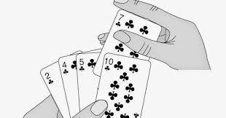
Insertion sort (Example)

Slide 140
Insertion sort (Example)

Slide 141
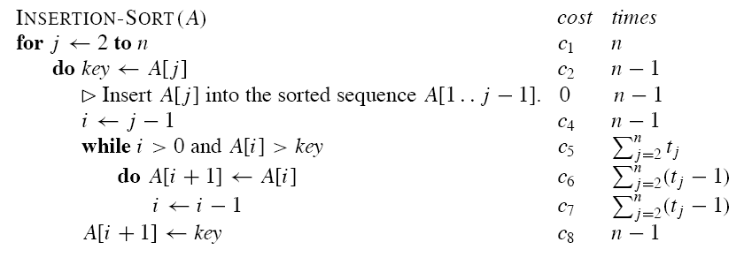
Insertion sort (Algorithm)

Slide 142
Divide and Conquer strategy
(Merge Sort)

Slide 143
Overview
• Learn the technique of “divide and conquer”
in the context of merge sort.

Slide 144
A Sorting Problem
(Divide and Conquer Approach)
Divide the problem into a number of sub problems.
Conquer the sub problems by solving them recursively.
  Base case: If the sub problems are small enough, just solve them by brute force.
Combine the sub problem solutions to give a solution to the original problem.

Slide 145
Merge sort
A sorting algorithm based on divide and conquer. Its worst-case running time has a lower order of growth than insertion sort.
Because we are dealing with sub problems, we state each sub problem as sorting a sub array A[p . . r ].
Initially, p = 1 and r = n, but these values change as we recurse through sub problems.
To sort A[p . . r ]:
Divide by splitting into two sub arrays A[p . . q] and A[q + 1 . . r ], where q is the halfway point of A[p . . r ].
Conquer by recursively sorting the two sub arrays A[p . . q] and A[q + 1 . . r ].
Combine by merging the two sorted sub arrays A[p . . q] and A[q + 1 . . r ] to produce a single sorted sub array A[p . . r ]. To accomplish this step, we’ll define a procedure MERGE(A, p, q, r ).

Slide 146
Merge Sort (Algorithm)
The recursion bottoms out when the subarray has just 1 element, so that it’s trivially sorted.

Slide 147
Merging
Input: Array A and indices p, q, r such that
    p ≤ q < r .
    Subarray A[p . . q] is sorted and subarray A[q + 1 . . r ] is sorted. By the restrictions on p, q, r , neither subarray is empty.
Output: The two subarrays are merged into a single sorted subarray in A[p . . r ].
We implement it so that it takes (n) time, where n = r − p + 1 = the number of elements being merged.

Slide 148
Pseudocode (Merging)

Slide 149
98
23
45
14
6
67
33
42

Slide 150
98
23
45
14
6
67
33
42
98
23
45
14
6
67
33
42

Slide 151
98
23
45
14
6
67
33
42
98
23
45
14
6
67
33
42
98
23
45
14

Slide 152
98
23
45
14
6
67
33
42
98
23
45
14
6
67
33
42
98
23
45
14
98
23

Slide 153
98
23
45
14
6
67
33
42
98
23
45
14
6
67
33
42
98
23
45
14
98
23
Merge

Slide 154
98
23
45
14
6
67
33
42
98
23
45
14
6
67
33
42
98
23
45
14
98
23
23
Merge

Slide 155
98
23
45
14
6
67
33
42
98
23
45
14
6
67
33
42
98
23
45
14
98
23
23
98
Merge

Slide 156
98
23
45
14
6
67
33
42
98
23
45
14
6
67
33
42
98
23
45
14
98
23
45
14
23
98

Slide 157
98
23
45
14
6
67
33
42
98
23
45
14
6
67
33
42
98
23
45
14
98
23
45
14
23
98
Merge

Slide 158
98
23
45
14
6
67
33
42
98
23
45
14
6
67
33
42
98
23
45
14
98
23
45
14
23
98
14
Merge

Slide 159
98
23
45
14
6
67
33
42
98
23
45
14
6
67
33
42
98
23
45
14
98
23
45
14
23
98
14
45
Merge

Slide 160
98
23
45
14
6
67
33
42
98
23
45
14
6
67
33
42
98
23
45
14
98
23
45
14
23
98
14
45
Merge

Slide 161
98
23
45
14
6
67
33
42
98
23
45
14
6
67
33
42
98
23
45
14
98
23
45
14
23
98
14
45
14
Merge

Slide 162
98
23
45
14
6
67
33
42
98
23
45
14
6
67
33
42
98
23
45
14
98
23
45
14
23
98
14
45
14
23
Merge

Slide 163
98
23
45
14
6
67
33
42
98
23
45
14
6
67
33
42
98
23
45
14
98
23
45
14
23
98
14
45
14
23
45
Merge

Slide 164
98
23
45
14
6
67
33
42
98
23
45
14
6
67
33
42
98
23
45
14
98
23
45
14
23
98
14
45
14
23
45
98
Merge

Slide 165
98
23
45
14
6
67
33
42
98
23
45
14
6
67
33
42
98
23
45
14
6
67
33
42
98
23
45
14
23
98
14
45
14
23
45
98

Slide 166
98
23
45
14
6
67
33
42
98
23
45
14
6
67
33
42
98
23
45
14
6
67
33
42
98
23
45
14
6
67
23
98
14
45
14
23
45
98

Slide 167
98
23
45
14
6
67
33
42
98
23
45
14
6
67
33
42
98
23
45
14
6
67
33
42
98
23
45
14
6
67
23
98
14
45
14
23
45
98
Merge

Slide 168
98
23
45
14
6
67
33
42
98
23
45
14
6
67
33
42
98
23
45
14
6
67
33
42
98
23
45
14
6
67
23
98
14
45
6
14
23
45
98
Merge

Slide 169
98
23
45
14
6
67
33
42
98
23
45
14
6
67
33
42
98
23
45
14
6
67
33
42
98
23
45
14
6
67
23
98
14
45
6
67
14
23
45
98
Merge

Slide 170
98
23
45
14
6
67
33
42
98
23
45
14
6
67
33
42
98
23
45
14
6
67
33
42
98
23
45
14
6
67
33
42
23
98
14
45
6
67
14
23
45
98

Slide 171
98
23
45
14
6
67
33
42
98
23
45
14
6
67
33
42
98
23
45
14
6
67
33
42
98
23
45
14
6
67
33
42
23
98
14
45
6
67
14
23
45
98
Merge

Slide 172
98
23
45
14
6
67
33
42
98
23
45
14
6
67
33
42
98
23
45
14
6
67
33
42
98
23
45
14
6
67
33
42
23
98
14
45
6
67
33
14
23
45
98
Merge

Slide 173
98
23
45
14
6
67
33
42
98
23
45
14
6
67
33
42
98
23
45
14
6
67
33
42
98
23
45
14
6
67
33
42
23
98
14
45
6
67
33
42
14
23
45
98
Merge

Slide 174
98
23
45
14
6
67
33
42
98
23
45
14
6
67
33
42
98
23
45
14
6
67
33
42
98
23
45
14
6
67
33
42
23
98
14
45
6
67
33
42
14
23
45
98
Merge

Slide 175
98
23
45
14
6
67
33
42
98
23
45
14
6
67
33
42
98
23
45
14
6
67
33
42
98
23
45
14
6
67
33
42
23
98
14
45
6
67
33
42
14
23
45
98
6
Merge

Slide 176
98
23
45
14
6
67
33
42
98
23
45
14
6
67
33
42
98
23
45
14
6
67
33
42
98
23
45
14
6
67
33
42
23
98
14
45
6
67
33
42
14
23
45
98
6
33
Merge

Slide 177
98
23
45
14
6
67
33
42
98
23
45
14
6
67
33
42
98
23
45
14
6
67
33
42
98
23
45
14
6
67
33
42
23
98
14
45
6
67
33
42
14
23
45
98
6
33
42
Merge

Slide 178
98
23
45
14
6
67
33
42
98
23
45
14
6
67
33
42
98
23
45
14
6
67
33
42
98
23
45
14
6
67
33
42
23
98
14
45
6
67
33
42
14
23
45
98
6
33
42
67
Merge

Slide 179
98
23
45
14
6
67
33
42
98
23
45
14
6
67
33
42
98
23
45
14
6
67
33
42
98
23
45
14
6
67
33
42
23
98
14
45
6
67
33
42
14
23
45
98
6
33
42
67
Merge

Slide 180
98
23
45
14
6
67
33
42
98
23
45
14
6
67
33
42
98
23
45
14
6
67
33
42
98
23
45
14
6
67
33
42
23
98
14
45
6
67
33
42
14
23
45
98
6
33
42
67
6
Merge

Slide 181
98
23
45
14
6
67
33
42
98
23
45
14
6
67
33
42
98
23
45
14
6
67
33
42
98
23
45
14
6
67
33
42
23
98
14
45
6
67
33
42
14
23
45
98
6
33
42
67
6
14
Merge

Slide 182
98
23
45
14
6
67
33
42
98
23
45
14
6
67
33
42
98
23
45
14
6
67
33
42
98
23
45
14
6
67
33
42
23
98
14
45
6
67
33
42
14
23
45
98
6
33
42
67
6
14
23
Merge

Slide 183
98
23
45
14
6
67
33
42
98
23
45
14
6
67
33
42
98
23
45
14
6
67
33
42
98
23
45
14
6
67
33
42
23
98
14
45
6
67
33
42
14
23
45
98
6
33
42
67
6
14
23
33
Merge

Slide 184
98
23
45
14
6
67
33
42
98
23
45
14
6
67
33
42
98
23
45
14
6
67
33
42
98
23
45
14
6
67
33
42
23
98
14
45
6
67
33
42
14
23
45
98
6
33
42
67
6
14
23
33
42
Merge

Slide 185
98
23
45
14
6
67
33
42
98
23
45
14
6
67
33
42
98
23
45
14
6
67
33
42
98
23
45
14
6
67
33
42
23
98
14
45
6
67
33
42
14
23
45
98
6
33
42
67
6
14
23
33
42
45
Merge

Slide 186
98
23
45
14
6
67
33
42
98
23
45
14
6
67
33
42
98
23
45
14
6
67
33
42
98
23
45
14
6
67
33
42
23
98
14
45
6
67
33
42
14
23
45
98
6
33
42
67
6
14
23
33
42
45
67
Merge

Slide 187
98
23
45
14
6
67
33
42
98
23
45
14
6
67
33
42
98
23
45
14
6
67
33
42
98
23
45
14
6
67
33
42
23
98
14
45
6
67
33
42
14
23
45
98
6
33
42
67
6
14
23
33
42
45
67
98
Merge

Slide 188
98
23
45
14
6
67
33
42
98
23
45
14
6
67
33
42
98
23
45
14
6
67
33
42
98
23
45
14
6
67
33
42
23
98
14
45
6
67
33
42
14
23
45
98
6
33
42
67
6
14
23
33
42
45
67
98

Slide 189
98
23
45
14
6
67
33
42
6
14
23
33
42
45
67
98

Slide 190
Example [A call of MERGE(9, 12, 16)]

Slide 192
Analyzing divide-and-conquer algorithms

Slide 193
Analyzing merge sort

Slide 194
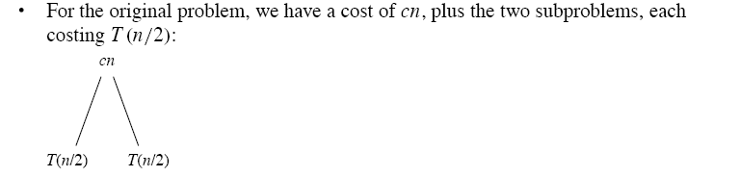
Recursion tree (Step 1)

Slide 195
Recursion tree (Step 2)

Slide 196
Recursion tree (Step n)

Slide 197
Divide and Conquer strategy
(Quick Sort)

Slide 198
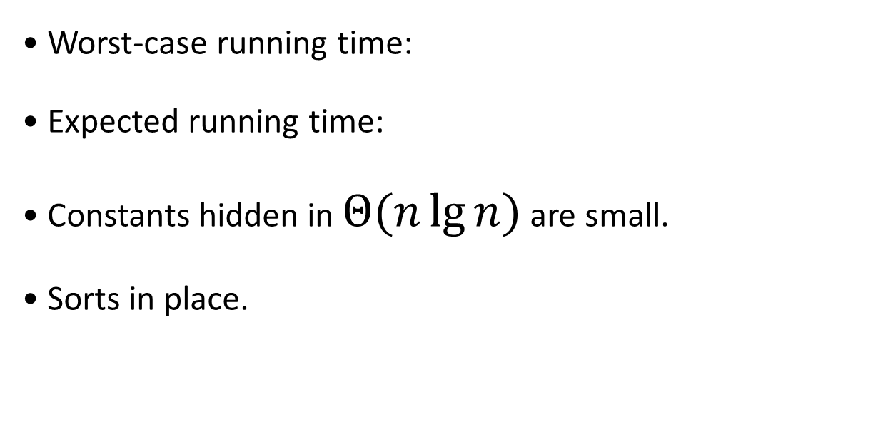


Overview
• Worst-case running time:
• Expected running time:
• Constants hidden in $Θ(n\lg{n)}$ are small.
• Sorts in place.
$$Θ(n^{2})$$
$$Θ(n\lg{n)}$$

Slide 199
Description of quicksort

Slide 201
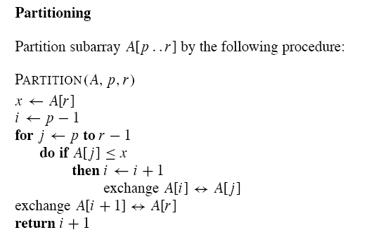

Slide 202
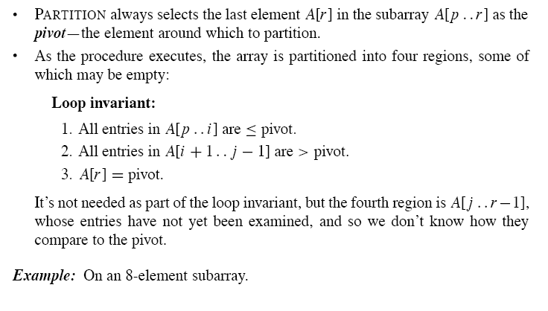

Slide 203
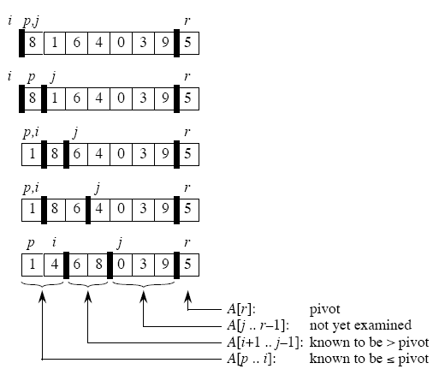

Slide 206
Performance of quicksort
The running time of quicksort depends on the partitioning of the subarrays:
• If the subarrays are balanced, then quicksort can run as fast as mergesort.
• If they are unbalanced, then quicksort can run as slowly as insertion sort.

Slide 208
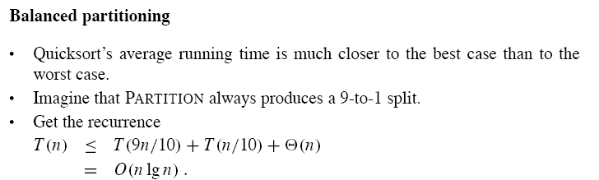

Slide 209
Randomized version of quicksort
• We have assumed that all input permutations are equally likely.
• This is not always true.
• To correct this, we add randomization to quicksort.
• We could randomly permute the input array.
• Instead, we use random sampling, or picking one element at random.
• Don’t always use A[r ] as the pivot. Instead, randomly pick an element from the subarray that is being sorted.
We add this randomization by not always using A[r ] as the pivot, but instead randomly picking an element from the subarray that is being sorted

Slide 211
Analysis of quicksort
We will analyze
• the worst-case running time of RANDOMIZED-QUICKSORT is average-case running time of QUICKSORT that is O(n lg n) .

Slide 212
Algorithm Analysis and Design
Linear Time Sorting
(Counting Sort)

Slide 213
Overview
Running time of counting sort is O(n+k).
Required extra space for sorting.
Is a stable sorting.

Slide 214
Counting Sort
Counting sort is a type of sorting technique which is based on keys between a specific range.
It works by counting the number of objects having distinct key values (i.e. one kind of hashing).

Slide 215
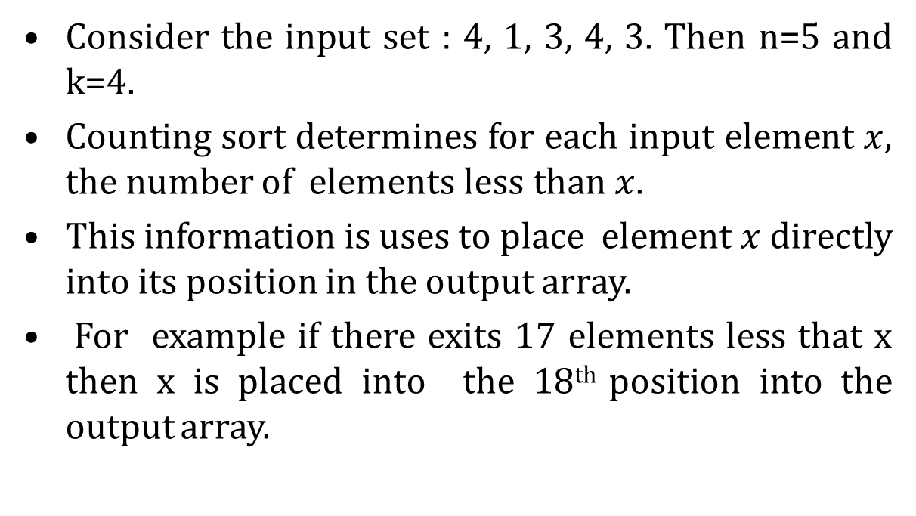
Counting Sort
Consider the input set : 4, 1, 3, 4, 3. Then n=5 and k=4.
Counting sort determines for each input element $x$, the number of elements less than $x$.
This information is uses to place element $x$ directly into its position in the output array.
For example if there exits 17 elements less that x then x is placed into the 18th position into the output array.

Slide 216
Counting Sort
Assumptions:
    n records
    Each record contains keys or data
    All keys are in the range of 0 to k, where k is the highest key value of the array.
Space:
For coding this algorithm uses three array:
  Input Array: A[1..n] store input data , where n is the length of the array.
  Output Array: B[1..n] finally store the sorted data
  Temporary Array: C[0..k] store data temporarily

Slide 217
Counting Sort
Let us illustrate the counting sort with an example.
Apply the concept of counting sort on the given array.
 | 1 | 2 | 3 | 4 | 5 | 6 | 7 | 8
A | 2 | 5 | 3 | 0 | 2 | 3 | 0 | 3

Slide 218
Counting Sort
Let us illustrate the counting sort with an example. Apply the concept of counting sort on the given array.
First create a new array C[0…..k] , where k is the highest key value. And initialize with 0(i.e. zero)
for i=0 to k
C[i]= 0;
 | 1 | 2 | 3 | 4 | 5 | 6 | 7 | 8
A | 2 | 5 | 3 | 0 | 2 | 3 | 0 | 3
 | 0 | 1 | 2 | 3 | 4 | 5
C | 0 | 0 | 0 | 0 | 0 | 0

Slide 219
Counting Sort
Let us illustrate the counting sort with an example.
Apply the concept of counting sort on the given array.
Find the frequencies of each object and store it in C array.
 | 1 | 2 | 3 | 4 | 5 | 6 | 7 | 8
A | 2 | 5 | 3 | 0 | 2 | 3 | 0 | 3
for j=1 to A. length
C[ A[j] ] = C[ A[j] ] + 1;
 | 0 | 1 | 2 | 3 | 4 | 5
C | 2 | 0 | 2 | 3 | 0 | 1

Slide 220
Counting Sort
Let us illustrate the counting sort with an example.
Apply the concept of counting sort on the given array.
Find the frequencies of each object and store it in C array.
And then cumulatively add C array.
for i=1 to k
C[i] = C[i] + C[i-1];
 | 1 | 2 | 3 | 4 | 5 | 6 | 7 | 8
A | 2 | 5 | 3 | 0 | 2 | 3 | 0 | 3
for j=1 to A. length
C[ A[j] ] = C[ A[j] ] + 1;
 | 0 | 1 | 2 | 3 | 4 | 5
C | 2 | 0 | 2 | 3 | 0 | 1
 | 0 | 1 | 2 | 3 | 4 | 5
C | 2 | 2 | 4 | 7 | 7 | 8

Slide 221
Counting Sort
for j=A. length down to 1
B[C[ A[j] ]] = A[j];
C[ A[j] ] = C[ A[j] ] - 1;
 |  |  |  |  |  | 1 | 2 | 3 | 4 | 5 | 6 | 7 | 8
 |  |  |  |  | A | 2 | 5 | 3 | 0 | 2 | 3 | 0 | 3
 |  |  |  |  |  |  |  |  |  |  |  |  | j
 | 1 | 2 | 3 | 4 | 5 | 6 | 7 | 8 |  |  | 0 | 1 | 2 | 3 | 4 | 5
B |  |  |  |  |  |  | 3 |  |  | C | 2 | 2 | 4 | 7 | 7 | 8

Slide 222
Counting Sort
for j=A. length down to 1
B[C[ A[j] ]] = A[j];
C[ A[j] ] = C[ A[j] ] - 1;
 |  |  |  |  |  | 1 | 2 | 3 | 4 | 5 | 6 | 7 | 8
 |  |  |  |  | A | 2 | 5 | 3 | 0 | 2 | 3 | 0 | 3
 |  |  |  |  |  |  |  |  |  |  |  |  | j
 | 1 | 2 | 3 | 4 | 5 | 6 | 7 | 8 |  |  | 0 | 1 | 2 | 3 | 4 | 5
B |  |  |  |  |  |  | 3 |  |  | C | 2 | 2 | 4 | 7 | 7 | 8
 |  |  |  |  |  | 1 | 2 | 3 | 4 | 5 | 6 | 7 | 8
 |  |  |  |  | A | 2 | 5 | 3 | 0 | 2 | 3 | 0 | 3
 |  |  |  |  |  |  |  |  |  |  |  |  | j
 | 1 | 2 | 3 | 4 | 5 | 6 | 7 | 8 |  |  | 0 | 1 | 2 | 3 | 4 | 5
B |  |  |  |  |  |  | 3 |  |  | C | 2 | 2 | 4 | 6 | 7 | 8

Slide 223
Counting Sort
for j=A. length down to 1
B[C[ A[j] ]] = A[j];
C[ A[j] ] = C[ A[j] ] - 1;
 |  |  |  |  |  | 1 | 2 | 3 | 4 | 5 | 6 | 7 | 8
 |  |  |  |  | A | 2 | 5 | 3 | 0 | 2 | 3 | 0 | 3
 |  |  |  |  |  |  |  |  |  |  |  | j
 | 1 | 2 | 3 | 4 | 5 | 6 | 7 | 8 |  |  | 0 | 1 | 2 | 3 | 4 | 5
B |  | 0 |  |  |  |  | 3 |  |  | C | 2 | 2 | 4 | 6 | 7 | 8

Slide 224
Counting Sort
for j=A. length down to 1
B[C[ A[j] ]] = A[j];
C[ A[j] ] = C[ A[j] ] - 1;
 |  |  |  |  |  | 1 | 2 | 3 | 4 | 5 | 6 | 7 | 8
 |  |  |  |  | A | 2 | 5 | 3 | 0 | 2 | 3 | 0 | 3
 |  |  |  |  |  |  |  |  |  |  |  | j
 | 1 | 2 | 3 | 4 | 5 | 6 | 7 | 8 |  |  | 0 | 1 | 2 | 3 | 4 | 5
B |  | 0 |  |  |  |  | 3 |  |  | C | 2 | 2 | 4 | 6 | 7 | 8
 |  |  |  |  |  | 1 | 2 | 3 | 4 | 5 | 6 | 7 | 8
 |  |  |  |  | A | 2 | 5 | 3 | 0 | 2 | 3 | 0 | 3
 |  |  |  |  |  |  |  |  |  |  |  | j
 | 1 | 2 | 3 | 4 | 5 | 6 | 7 | 8 |  |  | 0 | 1 | 2 | 3 | 4 | 5
B |  | 0 |  |  |  |  | 3 |  |  | C | 1 | 2 | 4 | 6 | 7 | 8

Slide 225
Counting Sort
for j=A. length down to 1
B[C[ A[j] ]] = A[j];
C[ A[j] ] = C[ A[j] ] - 1;
 |  |  |  |  |  | 1 | 2 | 3 | 4 | 5 | 6 | 7 | 8
 |  |  |  |  | A | 2 | 5 | 3 | 0 | 2 | 3 | 0 | 3
 |  |  |  |  |  |  |  |  |  |  | j
 | 1 | 2 | 3 | 4 | 5 | 6 | 7 | 8 |  |  | 0 | 1 | 2 | 3 | 4 | 5
B |  | 0 |  |  |  | 3 | 3 |  |  | C | 1 | 2 | 4 | 6 | 7 | 8

Slide 226
Counting Sort
for j=A. length down to 1
B[C[ A[j] ]] = A[j];
C[ A[j] ] = C[ A[j] ] - 1;
 |  |  |  |  |  | 1 | 2 | 3 | 4 | 5 | 6 | 7 | 8
 |  |  |  |  | A | 2 | 5 | 3 | 0 | 2 | 3 | 0 | 3
 |  |  |  |  |  |  |  |  |  |  | j
 | 1 | 2 | 3 | 4 | 5 | 6 | 7 | 8 |  |  | 0 | 1 | 2 | 3 | 4 | 5
B |  | 0 |  |  |  | 3 | 3 |  |  | C | 1 | 2 | 4 | 6 | 7 | 8
 |  |  |  |  |  | 1 | 2 | 3 | 4 | 5 | 6 | 7 | 8
 |  |  |  |  | A | 2 | 5 | 3 | 0 | 2 | 3 | 0 | 3
 |  |  |  |  |  |  |  |  |  |  | j
 | 1 | 2 | 3 | 4 | 5 | 6 | 7 | 8 |  |  | 0 | 1 | 2 | 3 | 4 | 5
B |  | 0 |  |  |  | 3 | 3 |  |  | C | 1 | 2 | 4 | 5 | 7 | 8

Slide 227
Counting Sort
for j=A. length down to 1
B[C[ A[j] ]] = A[j];
C[ A[j] ] = C[ A[j] ] - 1;
 |  |  |  |  |  | 1 | 2 | 3 | 4 | 5 | 6 | 7 | 8
 |  |  |  |  | A | 2 | 5 | 3 | 0 | 2 | 3 | 0 | 3
 |  |  |  |  |  |  |  |  |  | j
 | 1 | 2 | 3 | 4 | 5 | 6 | 7 | 8 |  |  | 0 | 1 | 2 | 3 | 4 | 5
B |  | 0 |  | 2 |  | 3 | 3 |  |  | C | 1 | 2 | 4 | 5 | 7 | 8

Slide 228
Counting Sort
for j=A. length down to 1
B[C[ A[j] ]] = A[j];
C[ A[j] ] = C[ A[j] ] - 1;
 |  |  |  |  |  | 1 | 2 | 3 | 4 | 5 | 6 | 7 | 8
 |  |  |  |  | A | 2 | 5 | 3 | 0 | 2 | 3 | 0 | 3
 |  |  |  |  |  |  |  |  |  | j
 | 1 | 2 | 3 | 4 | 5 | 6 | 7 | 8 |  |  | 0 | 1 | 2 | 3 | 4 | 5
B |  | 0 |  | 2 |  | 3 | 3 |  |  | C | 1 | 2 | 4 | 5 | 7 | 8
 |  |  |  |  |  | 1 | 2 | 3 | 4 | 5 | 6 | 7 | 8
 |  |  |  |  | A | 2 | 5 | 3 | 0 | 2 | 3 | 0 | 3
 |  |  |  |  |  |  |  |  |  | j
 | 1 | 2 | 3 | 4 | 5 | 6 | 7 | 8 |  |  | 0 | 1 | 2 | 3 | 4 | 5
B |  | 0 |  | 2 |  | 3 | 3 |  |  | C | 1 | 2 | 3 | 5 | 7 | 8

Slide 229
Counting Sort
for j=A. length down to 1
B[C[ A[j] ]] = A[j];
C[ A[j] ] = C[ A[j] ] - 1;
 |  |  |  |  |  | 1 | 2 | 3 | 4 | 5 | 6 | 7 | 8
 |  |  |  |  | A | 2 | 5 | 3 | 0 | 2 | 3 | 0 | 3
 |  |  |  |  |  |  |  |  | j
 | 1 | 2 | 3 | 4 | 5 | 6 | 7 | 8 |  |  | 0 | 1 | 2 | 3 | 4 | 5
B | 0 | 0 |  | 2 |  | 3 | 3 |  |  | C | 1 | 2 | 3 | 5 | 7 | 8

Slide 230
Counting Sort
for j=A. length down to 1
B[C[ A[j] ]] = A[j];
C[ A[j] ] = C[ A[j] ] - 1;
 |  |  |  |  |  | 1 | 2 | 3 | 4 | 5 | 6 | 7 | 8
 |  |  |  |  | A | 2 | 5 | 3 | 0 | 2 | 3 | 0 | 3
 |  |  |  |  |  |  |  |  | j
 | 1 | 2 | 3 | 4 | 5 | 6 | 7 | 8 |  |  | 0 | 1 | 2 | 3 | 4 | 5
B | 0 | 0 |  | 2 |  | 3 | 3 |  |  | C | 1 | 2 | 3 | 5 | 7 | 8
 |  |  |  |  |  | 1 | 2 | 3 | 4 | 5 | 6 | 7 | 8
 |  |  |  |  | A | 2 | 5 | 3 | 0 | 2 | 3 | 0 | 3
 |  |  |  |  |  |  |  |  | j
 | 1 | 2 | 3 | 4 | 5 | 6 | 7 | 8 |  |  | 0 | 1 | 2 | 3 | 4 | 5
B | 0 | 0 |  | 2 |  | 3 | 3 |  |  | C | 0 | 2 | 3 | 5 | 7 | 8

Slide 231
Counting Sort
for j=A. length down to 1
B[C[ A[j] ]] = A[j];
C[ A[j] ] = C[ A[j] ] - 1;
 |  |  |  |  |  | 1 | 2 | 3 | 4 | 5 | 6 | 7 | 8
 |  |  |  |  | A | 2 | 5 | 3 | 0 | 2 | 3 | 0 | 3
 |  |  |  |  |  |  |  | j
 | 1 | 2 | 3 | 4 | 5 | 6 | 7 | 8 |  |  | 0 | 1 | 2 | 3 | 4 | 5
B | 0 | 0 |  | 2 | 3 | 3 | 3 |  |  | C | 0 | 2 | 3 | 5 | 7 | 8

Slide 232
Counting Sort
for j=A. length down to 1
B[C[ A[j] ]] = A[j];
C[ A[j] ] = C[ A[j] ] - 1;
 |  |  |  |  |  | 1 | 2 | 3 | 4 | 5 | 6 | 7 | 8
 |  |  |  |  | A | 2 | 5 | 3 | 0 | 2 | 3 | 0 | 3
 |  |  |  |  |  |  |  | j
 | 1 | 2 | 3 | 4 | 5 | 6 | 7 | 8 |  |  | 0 | 1 | 2 | 3 | 4 | 5
B | 0 | 0 |  | 2 | 3 | 3 | 3 |  |  | C | 0 | 2 | 3 | 5 | 7 | 8
 |  |  |  |  |  | 1 | 2 | 3 | 4 | 5 | 6 | 7 | 8
 |  |  |  |  | A | 2 | 5 | 3 | 0 | 2 | 3 | 0 | 3
 |  |  |  |  |  |  |  | j
 | 1 | 2 | 3 | 4 | 5 | 6 | 7 | 8 |  |  | 0 | 1 | 2 | 3 | 4 | 5
B | 0 | 0 |  | 2 | 3 | 3 | 3 |  |  | C | 0 | 2 | 3 | 4 | 7 | 8

Slide 233
Counting Sort
for j=A. length down to 1
B[C[ A[j] ]] = A[j];
C[ A[j] ] = C[ A[j] ] - 1;
 |  |  |  |  |  | 1 | 2 | 3 | 4 | 5 | 6 | 7 | 8
 |  |  |  |  | A | 2 | 5 | 3 | 0 | 2 | 3 | 0 | 3
 |  |  |  |  |  |  | j
 | 1 | 2 | 3 | 4 | 5 | 6 | 7 | 8 |  |  | 0 | 1 | 2 | 3 | 4 | 5
B | 0 | 0 |  | 2 | 3 | 3 | 3 | 5 |  | C | 0 | 2 | 3 | 4 | 7 | 8

Slide 234
Counting Sort
for j=A. length down to 1
B[C[ A[j] ]] = A[j];
C[ A[j] ] = C[ A[j] ] - 1;
 |  |  |  |  |  | 1 | 2 | 3 | 4 | 5 | 6 | 7 | 8
 |  |  |  |  | A | 2 | 5 | 3 | 0 | 2 | 3 | 0 | 3
 |  |  |  |  |  |  | j
 | 1 | 2 | 3 | 4 | 5 | 6 | 7 | 8 |  |  | 0 | 1 | 2 | 3 | 4 | 5
B | 0 | 0 |  | 2 | 3 | 3 | 3 | 5 |  | C | 0 | 2 | 3 | 4 | 7 | 8
 |  |  |  |  |  | 1 | 2 | 3 | 4 | 5 | 6 | 7 | 8
 |  |  |  |  | A | 2 | 5 | 3 | 0 | 2 | 3 | 0 | 3
 |  |  |  |  |  |  | j
 | 1 | 2 | 3 | 4 | 5 | 6 | 7 | 8 |  |  | 0 | 1 | 2 | 3 | 4 | 5
B | 0 | 0 |  | 2 | 3 | 3 | 3 | 5 |  | C | 0 | 2 | 3 | 4 | 7 | 7

Slide 235
Counting Sort
for j=A. length down to 1
B[C[ A[j] ]] = A[j];
C[ A[j] ] = C[ A[j] ] - 1;
 |  |  |  |  |  | 1 | 2 | 3 | 4 | 5 | 6 | 7 | 8
 |  |  |  |  | A | 2 | 5 | 3 | 0 | 2 | 3 | 0 | 3
 |  |  |  |  |  | j
 | 1 | 2 | 3 | 4 | 5 | 6 | 7 | 8 |  |  | 0 | 1 | 2 | 3 | 4 | 5
B | 0 | 0 | 2 | 2 | 3 | 3 | 3 | 5 |  | C | 0 | 2 | 3 | 4 | 7 | 7

Slide 236
Counting Sort
for j=A. length down to 1
B[C[ A[j] ]] = A[j];
C[ A[j] ] = C[ A[j] ] - 1;
 |  |  |  |  |  | 1 | 2 | 3 | 4 | 5 | 6 | 7 | 8
 |  |  |  |  | A | 2 | 5 | 3 | 0 | 2 | 3 | 0 | 3
 |  |  |  |  |  | j
 | 1 | 2 | 3 | 4 | 5 | 6 | 7 | 8 |  |  | 0 | 1 | 2 | 3 | 4 | 5
B | 0 | 0 | 2 | 2 | 3 | 3 | 3 | 5 |  | C | 0 | 2 | 3 | 4 | 7 | 7
 |  |  |  |  |  | 1 | 2 | 3 | 4 | 5 | 6 | 7 | 8
 |  |  |  |  | A | 2 | 5 | 3 | 0 | 2 | 3 | 0 | 3
 |  |  |  |  |  | j
 | 1 | 2 | 3 | 4 | 5 | 6 | 7 | 8 |  |  | 0 | 1 | 2 | 3 | 4 | 5
B | 0 | 0 | 2 | 2 | 3 | 3 | 3 | 5 |  | C | 0 | 2 | 2 | 4 | 7 | 7

Slide 237
Counting Sort
Counting-Sort(A, B, k)
Let C[0…..k] be a new array
for i=0 to k
C[i]= 0;
for j=1 to A. length
C[ A[j] ] = C[ A[j] ] + 1;
for i=1 to k
C[i] = C[i] + C[i-1];
for j=A. length down to 1
B[C[ A[j] ]] = A[j];
C[ A[j] ] = C[ A[j] ] - 1;

Slide 238
Counting Sort
Counting-Sort(A, B, k)
1. Let C[0…..k] be a new array
2. for i=0 to k
3. C[i]= 0;
4. for j=1 to A. length
5. C[ A[j] ] = C[ A[j] ] + 1;
6. for i=1 to k
7. C[i] = C[i] + C[i-1];
8. for j=A. length down to 1
9. B[C[ A[j] ]] = A[j];
10. C[ A[j] ] = C[ A[j] ] - 1;
[Loop 1]
[Loop 2]
[Loop 3]
[Loop 4]

Slide 239
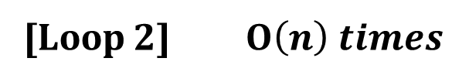
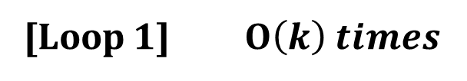
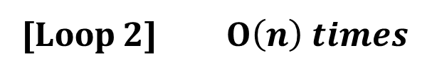
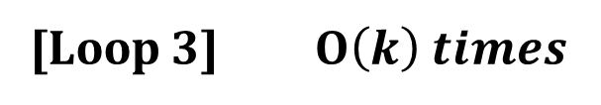
Complexity Analysis
Counting-Sort(A, B, k)
1. Let C[0…..k] be a new array
2. for i=0 to k
3. C[i]= 0;
4. for j=1 to A. length
5. C[ A[j] ] = C[ A[j] ] + 1;
6. for i=1 to k
7. C[i] = C[i] + C[i-1];
8. for j=A. length down to 1
9. B[C[ A[j] ]] = A[j];
10. C[ A[j] ] = C[ A[j] ] - 1;
[Loop 1] $Ο\left(k\right) times$
[Loop 2] $Ο\left(n\right) times$
[Loop 3] $Ο\left(k\right) times$
[Loop 2] $Ο\left(n\right) times$

Slide 240
Complexity Analysis
So the counting sort takes a total time of: O(n + k)
Counting sort is called stable sort.
( A sorting algorithm is stable when numbers with the same values appear in the output array in the same order as they do in the input array.)

Slide 241
Pro’s and Con’s of Counting Sort
Pro’s
  Asymptotically fast Fast - O(n + k)
  Simple to code
Con’s
  Doesn’t sort in place.
  Requires O(n + k) extra storage space.

Slide 242
Linear Time Sorting
(Radix Sort)

Slide 243

Overview
Running time of counting sort is $Θ(d\left(n+k\right))$
Required extra space for sorting.
Is a stable sorting.

Slide 244
Radix Sort
Radix sort is non comparative sorting method
Two classifications of radix sorts are least significant digit (LSD) radix sorts and most significant digit (MSD) radix sorts.
LSD radix sorts process the integer representations starting from the least digit and move towards the most significant digit. MSD radix sorts work the other way around.

Slide 245
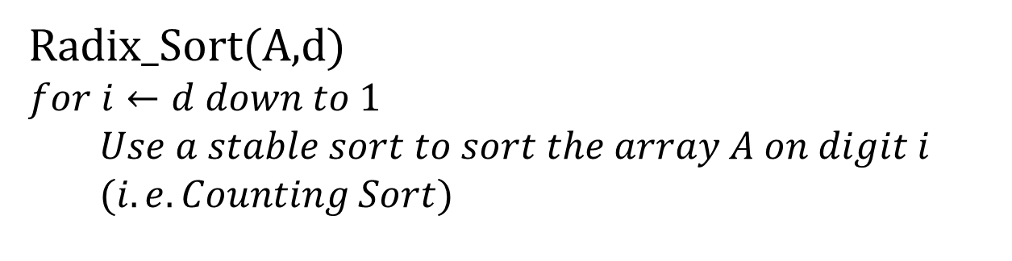
Radix Sort (Algorithm)
Radix_Sort(A,d)
$$for i←d down to 1$$
$$Use a stable sort to sort the array A on digit i$$
$$(i.e. Counting Sort)$$

Slide 246
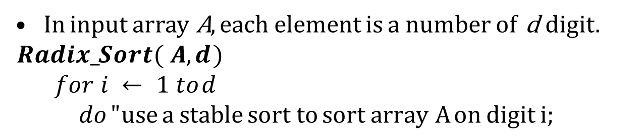
Radix Sort
In input array A, each element is a number of d digit. $Radix_Sort( A, d )$
$$for i ← 1 to d$$
$$do " use a stable sort to sort array A on digit i;$$
329
457
657
839
436
720
355

Slide 247
Radix Sort
In input array A, each element is a number of d digit. $Radix_Sort( A, d )$
$$for i ← 1 to d$$
$$do " use a stable sort to sort array A on digit i;$$
329 |  | 720
457 |  | 355
657 |  | 436
839 |  | 457
436 |  | 657
720 |  | 329
355 |  | 839

Slide 248
Radix Sort
In input array A, each element is a number of d digit. $Radix_Sort( A, d )$
$$for i ← 1 to d$$
$$do " use a stable sort to sort array A on digit i;$$
329 |  | 720 |  | 720
457 |  | 355 |  | 329
657 |  | 436 |  | 436
839 |  | 457 |  | 839
436 |  | 657 |  | 355
720 |  | 329 |  | 457
355 |  | 839 |  | 657

Slide 249
Radix Sort
In input array A, each element is a number of d digit. $Radix_Sort( A, d )$
$$for i ← 1 to d$$
$$do " use a stable sort to sort array A on digit i;$$
329 |  | 720 |  | 720 |  | 329
457 |  | 355 |  | 329 |  | 355
657 |  | 436 |  | 436 |  | 436
839 |  | 457 |  | 839 |  | 457
436 |  | 657 |  | 355 |  | 657
720 |  | 329 |  | 457 |  | 720
355 |  | 839 |  | 657 |  | 839

Slide 250
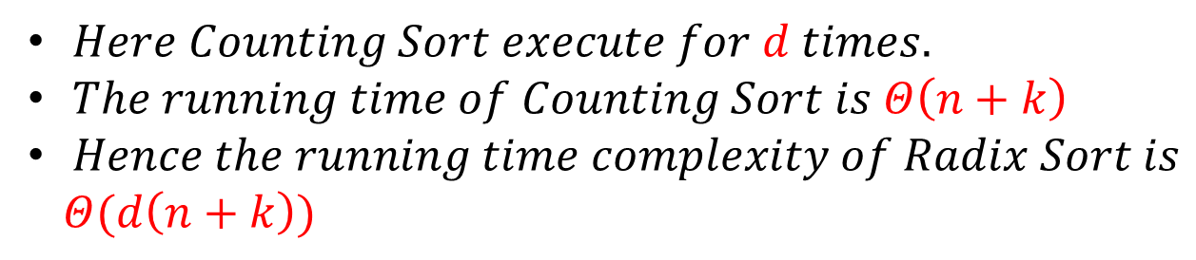
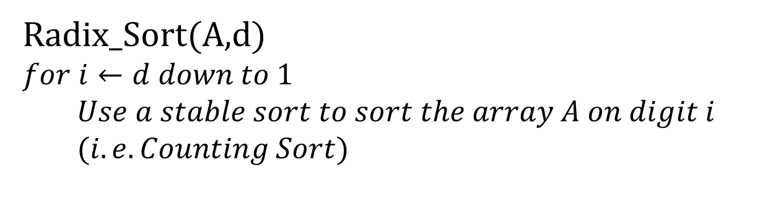
Radix Sort (Analysis)
Radix_Sort(A,d)
$$for i←d down to 1$$
$$Use a stable sort to sort the array A on digit i$$
$$(i.e. Counting Sort)$$
$Here Counting Sort execute for d times.$
$The running time of Counting Sort is Θ\left(n+k\right)$
$Hence the running time complexity of Radix Sort is$
$Θ(d\left(n+k\right))$

Slide 251
Divide and Conquer strategy
(Heap Sort)

Slide 252
Overview
• O(n lg n) worst case-like merge sort.
• Sorts in place-like insertion sort.
• Combines the best of both algorithms.

Slide 253
Heap data structure

Slide 254
Example

Slide 255
Example
Given an array of size N. The task is to sort the array elements by using Heap Sort.
  Input:
  N=10
  Arr[]:{16, 4, 10, 14, 7, 9, 3, 2, 8, 1}
  Output: 1 2 3 4 7 8 9 10 14 16

Slide 256
Example
Given an array of size N. The task is to sort the array elements by using Heap Sort.
  Input:
  N = 10
  arr[] = {10,9,8,7,6,5,4,3,2,1}
  Output:1 2 3 4 5 6 7 8 9 10

Slide 257
Heap property
For max-heaps (largest element at root), max-heap property: for all nodes i ,
excluding the root, A[PARENT(i )] ≥ A[i ].
For min-heaps (smallest element at root), min-heap property: for all nodes i ,
excluding the root, A[PARENT(i )] ≤ A[i ].

Slide 258
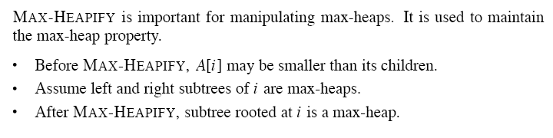
Maintaining the heap property

Slide 260
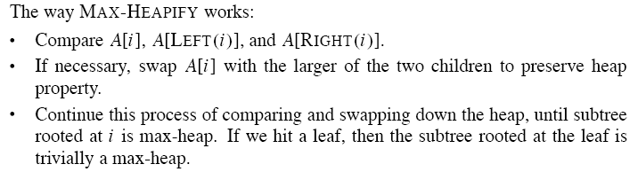

Slide 262
Building a heap

Slide 263
Example
Building a max-heap from the following unsorted array results in the
first heap example.

Slide 265
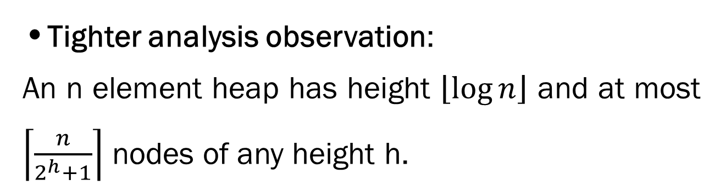
Analysis
• Simple bound: O(n) calls to MAX-HEAPIFY, each of which takes O(lg n) time ⇒ O(n lg n).
•Tighter analysis observation:
An n element heap has height $\left\lfloor \log{n}\right\rfloor$ and at most $\left\lceil \frac{n}{2^{h}+1}\right\rceil$ nodes of any height h.

Slide 266
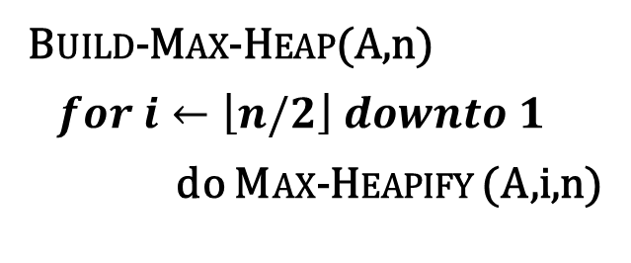
Tighter analysis Proof
Build-Max-Heap(A,n)
$for i←\left\lfloor n/2\right\rfloor downto 1$
do Max-Heapify (A,i,n)
9
6
5
i
0
8
2
1
1 | 2 | 3 | 4 | 5 | 6 | 7 | 8
9 | 6 | 5 | 0 | 8 | 2 | 1 | 3
3

Slide 267
Tighter analysis Proof
For easy understanding, Let us take a complete binary Tree,
The height of a node is the number of edges from the node to the deepest leaf.
The depth of a node is the no of edges from the root of the node.

Slide 268
Tighter analysis Proof
All the leaves are of height 0, therefore there are 8 nodes at height 0.
4 numbers of nodes at height 1.
2 numbers of nodes at height 2.
and one node at height 3.

Slide 269
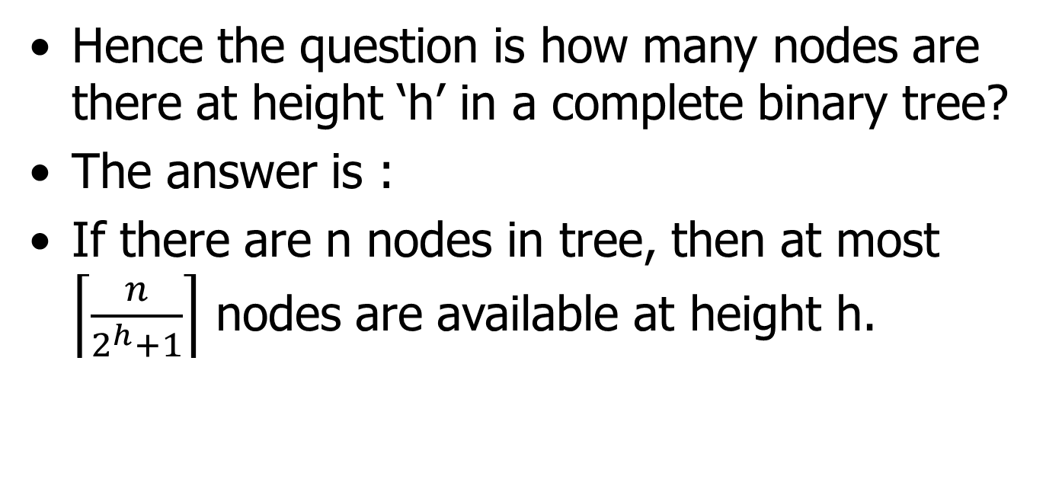
Tighter analysis Proof
Hence the question is how many nodes are there at height ‘h’ in a complete binary tree?
The answer is :
If there are n nodes in tree, then at most $\left\lceil \frac{n}{2^{h}+1}\right\rceil$ nodes are available at height h.

Slide 270
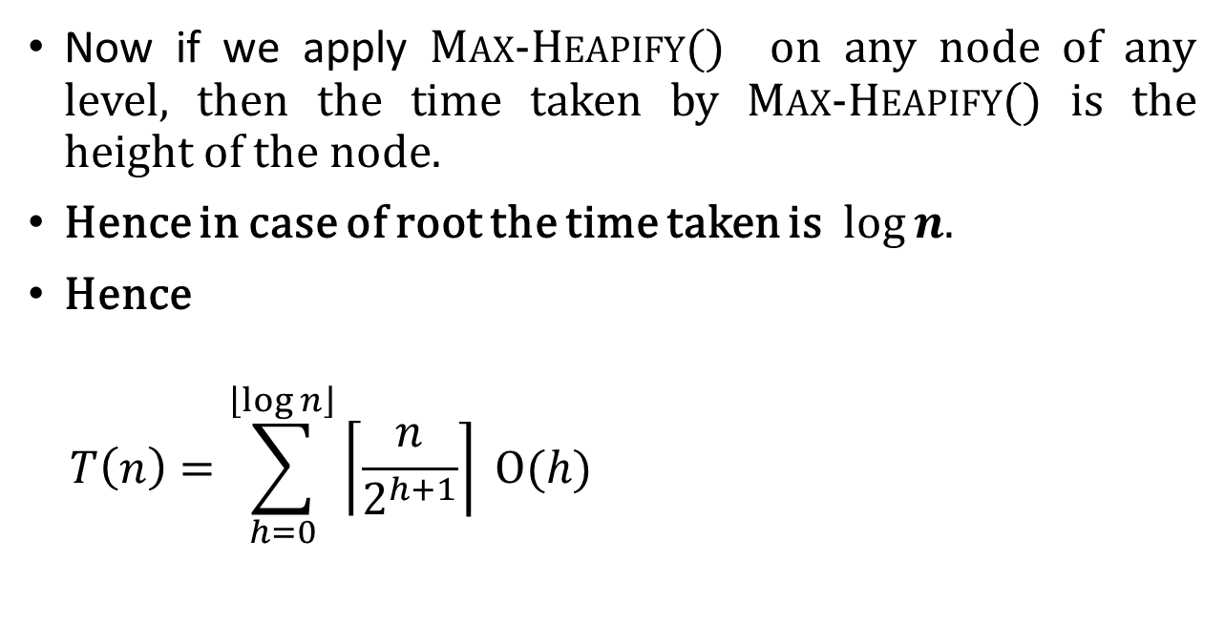
Tighter analysis Proof
Now if we apply Max-Heapify() on any node of any level, then the time taken by Max-Heapify() is the height of the node.
Hence in case of root the time taken is $log⁡n.$
Hence
$$T\left(n\right)=\sum_{h=0}^{\left\lfloor \log{n}\right\rfloor }{\left\lceil \frac{n}{2^{h+1}}\right\rceil }Ο(h)$$
Work done by Max-Heapify() on the number of nodes of height h.

Slide 271
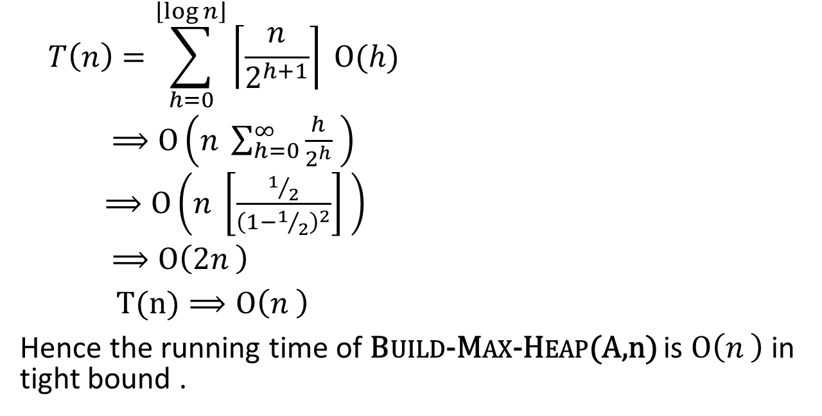
Tighter analysis Proof
$$T\left(n\right)=\sum_{h=0}^{\left\lfloor \log{n}\right\rfloor }{\left\lceil \frac{n}{2^{h+1}}\right\rceil }Ο(h)$$
$⟹Ο\left(n \sum_{h=0}^{∞}{\frac{h}{2^{h}} }\right)$
$⟹Ο\left(n \left[\frac{1/2}{{\left(1−1/2\right)}^{2}}\right] \right)$
$⟹Ο\left(2n \right)$
$T(n)⟹Ο\left(n \right)$
Hence the running time of Build-Max-Heap(A,n) is $Ο\left(n \right)$ in tight bound .

Slide 272
The heapsort algorithm
Given an input array, the heapsort algorithm acts as follows:
  • Builds a max-heap from the array.
  • Starting with the root (the maximum element), the algorithm places the maximum element into the correct place in the array by swapping it with the element in the last position in the array.
  • “Discard” this last node (knowing that it is in its correct place) by decreasing the heap size, and calling MAX-HEAPIFY on the new (possibly incorrectly-placed) root.
  • Repeat this “discarding” process until only one node (the smallest element) remains, and therefore is in the correct place in the array.

Slide 273
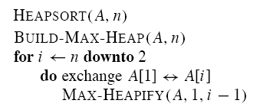

Slide 274
Example

Slide 275
Analysis
  • BUILD-MAX-HEAP: O(n)
  • for loop: n − 1 times
  • exchange elements: O(1)
  • MAX-HEAPIFY: O(lg n)
Total time: O(n lg n).

Slide 276
Heap implementation of priority queue
Heaps efficiently implement priority queues. These notes will deal with max priority queues implemented with max-heaps. Min-priority queues are implemented with min-heaps similarly.
A heap gives a good compromise between fast insertion but slow extraction and vice versa. Both operations take O(lg n) time.

Slide 277
Priority queue
Maintains a dynamic set S of elements.
• Each set element has a key-an associated value.
• Max-priority queue supports dynamic-set operations:
• INSERT(S, x): inserts element x into set S.
• MAXIMUM(S): returns element of S with largest key.
• EXTRACT-MAX(S): removes and returns element of S with largest key.
• INCREASE-KEY(S, x, k): increases value of element x’s key to k. Assume k ≥ x’s current key value.
• Example max-priority queue application: schedule jobs on shared computer.

Slide 278
• Min-priority queue supports similar operations:
• INSERT(S, x): inserts element x into set S.
• MINIMUM(S): returns element of S with smallest key.
• EXTRACT-MIN(S): removes and returns element of S with smallest key.
• DECREASE-KEY(S, x, k): decreases value of element x’s key to k. Assume k ≤ x’s current key value.
• Example min-priority queue application:
event - driven simulator.

Slide 279
Finding the maximum element
Getting the maximum element is easy: it’s the root.
HEAP-MAXIMUM(A)
return A[1]
Time: (1).

Slide 280
Extracting max element
Given the array A:
• Make sure heap is not empty.
• Make a copy of the maximum element (the root).
• Make the last node in the tree the new root.
• Re-heapify the heap, with one fewer node.
• Return the copy of the maximum element.
HEAP-EXTRACT-MAX(A, n)
if n < 1
then error .heap underflow.
max ← A[1]
A[1] ← A[n]
MAX-HEAPIFY(A, 1, n − 1) remakes heap
return max

Slide 281
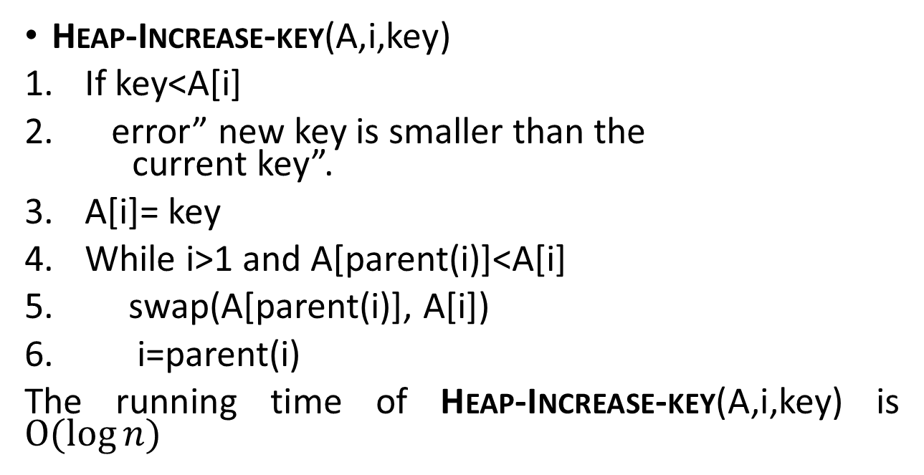
Heap-Increase-key(A,i,key)
If key<A[i]
error” new key is smaller than the current key”.
A[i]= key
While i>1 and A[parent(i)]<A[i]
swap(A[parent(i)], A[i])
i=parent(i)
The running time of Heap-Increase-key(A,i,key) is $Ο(\log{n)}$

Slide 282
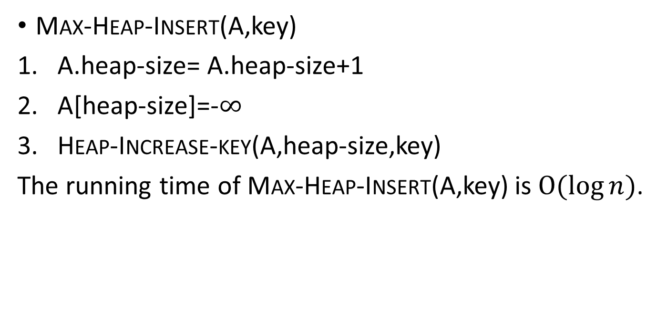
Max-Heap-Insert(A,key)
A.heap-size= A.heap-size+1
A[heap-size]=-$∞$
Heap-Increase-key(A,heap-size,key)
The running time of Max-Heap-Insert(A,key) is $Ο(\log{n)}$.

Slide 283
Linear Search, Binary Search

Slide 284
Problem: Search
We are given a list of records.
Each record has an associated key.
Give efficient algorithm for searching for a record containing a particular key.
Efficiency is quantified in terms of average time analysis (number of comparisons) to retrieve an item.

Slide 285
Search
[ 0 ]
[ 1 ]
[ 2 ]
[ 3 ]
[ 4 ]
[ 700 ]
…
Number 701466868
Number 281942902
Number 233667136
Number 580625685
Number 506643548
Number 155778322
Each record in list has an associated key.
In this example, the keys are ID numbers.
Given a particular key, how can we efficiently retrieve the record from the list?
Number 580625685

Slide 286
Serial Search
Step through array of records, one at a time.
Look for record with matching key.
Search stops when
  record with matching key is found
  or when search has examined all records without success.

Slide 287
Pseudocode for Serial Search
// Search for a desired item in the n array elements
// starting at a[first].
// Returns pointer to desired record if found.
// Otherwise, return NULL
…
for(i = first; i < n; ++i )
if(a[first+i] is desired item)
return &a[first+i];
// if we drop through loop, then desired item was not found
return NULL;

Slide 288
Serial Search Analysis
What are the worst and average case running times for serial search?
We must determine the O-notation for the number of operations required in search.
Number of operations depends on n, the number of entries in the list.

Slide 289
Worst Case Time for Serial Search
For an array of n elements, the worst case time for serial search requires n array accesses: O(n).
Consider cases where we must loop over all n records:
  desired record appears in the last position of the array
  desired record does not appear in the array at all

Slide 290
Average Case for Serial Search
Assumptions:
  All keys are equally likely in a search
  We always search for a key that is in the array
Example:
We have an array of 10 records.
If search for the first record, then it requires 1 array access; if the second, then 2 array accesses. etc.
The average of all these searches is:
  (1+2+3+4+5+6+7+8+9+10)/10 = 5.5

Slide 291
Average Case Time for Serial Search
Generalize for array size n.
Expression for average-case running time:
(1+2+…+n)/n = n(n+1)/2n = (n+1)/2
Therefore, average case time complexity for serial search is O(n).

Slide 292
Binary Search
Perhaps we can do better than O(n) in the average case?
Assume that we are give an array of records that is sorted. For instance:
  an array of records with integer keys sorted from smallest to largest (e.g., ID numbers), or
  an array of records with string keys sorted in alphabetical order (e.g., names).

Slide 293
Binary Search Pseudocode
…
if(size == 0)
found = false;
else {
middle = index of approximate midpoint of array segment;
if(target == a[middle])
target has been found!
else if(target < a[middle])
search for target in area before midpoint;
else
search for target in area after midpoint;
}
…

Slide 294
Binary Search
Example: sorted array of integer keys. Target=7.
[ 0 ]
[ 1 ]
[ 2 ]
[ 3 ]
[ 4 ]
[ 5 ]
[ 6 ]
3
6
7
11
32
33
53

Slide 295
Binary Search
Example: sorted array of integer keys. Target=7.
[ 0 ]
[ 1 ]
[ 2 ]
[ 3 ]
[ 4 ]
[ 5 ]
[ 6 ]
3
6
7
11
32
33
53
Find approximate midpoint

Slide 296
Binary Search
Example: sorted array of integer keys. Target=7.
[ 0 ]
[ 1 ]
[ 2 ]
[ 3 ]
[ 4 ]
[ 5 ]
[ 6 ]
3
6
7
11
32
33
53
Is 7 = midpoint key? NO.

Slide 297
Binary Search
Example: sorted array of integer keys. Target=7.
[ 0 ]
[ 1 ]
[ 2 ]
[ 3 ]
[ 4 ]
[ 5 ]
[ 6 ]
3
6
7
11
32
33
53
Is 7 < midpoint key? YES.

Slide 298
Binary Search
Example: sorted array of integer keys. Target=7.
[ 0 ]
[ 1 ]
[ 2 ]
[ 3 ]
[ 4 ]
[ 5 ]
[ 6 ]
3
6
7
11
32
33
53
Search for the target in the area before midpoint.

Slide 299
Binary Search
Example: sorted array of integer keys. Target=7.
[ 0 ]
[ 1 ]
[ 2 ]
[ 3 ]
[ 4 ]
[ 5 ]
[ 6 ]
3
6
7
11
32
33
53
Find approximate midpoint

Slide 300
Binary Search
Example: sorted array of integer keys. Target=7.
[ 0 ]
[ 1 ]
[ 2 ]
[ 3 ]
[ 4 ]
[ 5 ]
[ 6 ]
3
6
7
11
32
33
53
Target = key of midpoint? NO.

Slide 301
Binary Search
Example: sorted array of integer keys. Target=7.
[ 0 ]
[ 1 ]
[ 2 ]
[ 3 ]
[ 4 ]
[ 5 ]
[ 6 ]
3
6
7
11
32
33
53
Target < key of midpoint? NO.

Slide 302
Binary Search
Example: sorted array of integer keys. Target=7.
[ 0 ]
[ 1 ]
[ 2 ]
[ 3 ]
[ 4 ]
[ 5 ]
[ 6 ]
3
6
7
11
32
33
53
Target > key of midpoint? YES.

Slide 303
Binary Search
Example: sorted array of integer keys. Target=7.
[ 0 ]
[ 1 ]
[ 2 ]
[ 3 ]
[ 4 ]
[ 5 ]
[ 6 ]
3
6
7
11
32
33
53
Search for the target in the area after midpoint.

Slide 304
Binary Search
Example: sorted array of integer keys. Target=7.
[ 0 ]
[ 1 ]
[ 2 ]
[ 3 ]
[ 4 ]
[ 5 ]
[ 6 ]
3
6
7
11
32
33
53
Find approximate midpoint.
Is target = midpoint key? YES.

Slide 305
Binary Search Implementation
void search(const int a[ ], size_t first, size_t size, int target, bool& found, size_t& location)
{
size_t middle;
if(size == 0) found = false;
else {
middle = first + size/2;
if(target == a[middle]){
location = middle;
found = true;
}
else if (target < a[middle])
// target is less than middle, so search subarray before middle
search(a, first, size/2, target, found, location);
else
// target is greater than middle, so search subarray after middle
search(a, middle+1, (size-1)/2, target, found, location);
}
}

Slide 306
Relation to Binary Search Tree
Array of previous example:
3
6
7
11
32
33
53
Corresponding complete binary search tree
11
6
33
3
7
32
53

Slide 307
Search for target = 7
Find midpoint:
3
6
7
11
32
33
53
Start at root:
11
6
33
3
7
32
53

Slide 308
Search for target = 7
Search left subarray:
3
6
7
11
32
33
53
Search left subtree:
11
6
33
3
7
32
53

Slide 309
Search for target = 7
Find approximate midpoint of subarray:
3
6
7
11
32
33
53
Visit root of subtree:
11
6
33
3
7
32
53

Slide 310
Search for target = 7
Search right subarray:
3
6
7
11
32
33
53
Search right subtree:
11
6
33
3
7
32
53

Slide 311
Binary Search: Analysis
Worst case complexity?
What is the maximum depth of recursive calls in binary search as function of n?
Each level in the recursion, we split the array in half (divide by two).
Therefore maximum recursion depth is floor(log₂n) and worst case = O(log₂n).
Average case is also = O(log₂n).

Slide 312
Hash Tables
Constant time accesses!
A hash table is an array of some
fixed size, usually a prime number.
General idea:
hash table
0
 | …
hash function:
h(K)
key space (e.g., integers, strings)
TableSize –1

Slide 313
Example
0
1
2
3
4
5
6
7
8
9
key space = integers
TableSize = 10
h(K) = K mod 10
Insert: 7, 18, 41, 94

Slide 314
Another Example
key space = integers
TableSize = 6
h(K) = K mod 6
Insert: 7, 18, 41, 34
0
1
2
3
4
5
Notes:
7 (6*1 = 6)->1, 18-> 0, 41(6*6=36) -> 5, 34 (5*6)=30-> 4
Q: Why don’t we just create a table of size 100, or 40 and just map them directly to location?
A: Assumption is key space is much larger than the number of values we have to insert. (Ex. Using social security # as the key to put students in this class in a hash table. Table of size 999,999,999??)
Q: How long does that take to insert? O(1)
Q: How do we find them?
Q: How long does that take?
Q: What if we insert 12? (It wants to go in location 0 – CONFLICT)

Slide 315
Hash Functions
simple/fast to compute,
Avoid collisions
have keys distributed evenly among cells.
Perfect Hash function:

Slide 316
Sample Hash Functions:
26 letters, 10 digits, 1 _ = 37 possible characters
key space = strings
s = s₀ s₁ s₂ … s _{k-1}
h(s) = s₀ mod TableSize
h(s) = mod TableSize
h(s) = mod TableSize
Spread:
37
K*37
SPOT, POST,STOP
[s0 + s1*37 + s2*37^2+s3*37^3…] = O(37^k+1)
Notes:
3) Takes the position of each character into account, like with a positional number system.
[s0 + s1*37 + s2*37^2+s3*37^3]

Slide 317
Collision Resolution
Collision: when two keys map to the same location in the hash table.
Two ways to resolve collisions:
Separate Chaining
Open Addressing (linear probing, quadratic probing, double hashing)

Slide 318
Separate Chaining
Insert:
10
22
107
12
42
0
1
2
3
4
5
6
7
8
9
Separate chaining: All keys that map to the same hash value are kept in a list (or “bucket”).

Slide 319
Analysis of find
Defn: The load factor, λ, of a hash table is the ratio: ← no. of elements
← table size
For separate chaining, λ = average # of elements in a bucket
Unsuccessful find:
Successful find:
λ
  (avg. length of a list at hash(k))
1 + (λ/2)
  (one node, plus half the avg. length of a list (not including the item)).

Slide 320
How big should the hash table be?
For Separate Chaining:

Slide 321
tableSize: Why Prime?
Suppose
  data stored in hash table: 7160, 493, 60, 55, 321, 900, 810
  tableSize = 10
  data hashes to 0, 3, 0, 5, 1, 0, 0
  tableSize = 11
  data hashes to 10, 9, 5, 0, 2, 9, 7
Real-life data tends to have a pattern
Being a multiple of 11 is usually not the pattern ☺

Slide 322
Open Addressing
Insert:
38
19
8
109
10
0
1
2
3
4
5
6
7
8
9
Linear Probing: after checking spot h(k), try spot h(k)+1, if that is full, try h(k)+2, then h(k)+3, etc.

Slide 323
Terminology Alert!
“Open Hashing”
equals
“Separate Chaining”
“Closed Hashing”
equals
“Open Addressing”
Weiss

Slide 324
Linear Probing
f(i) = i
Probe sequence:
  0th probe = h(k) mod TableSize
  1th probe = (h(k) + 1) mod TableSize
  2th probe = (h(k) + 2) mod TableSize
  . . .
  i^{th} probe = (h(k) + i) mod TableSize
Notes:
Add a function of I to the original hash value to resolve the collision.
Primary clustering – we notice this effect in the previous slide.
Any key that hashes into the cluster 1) will require several attempts to resolve collision and 2) will then add to the cluster. (Both 1 and 2 are bad)

Slide 325
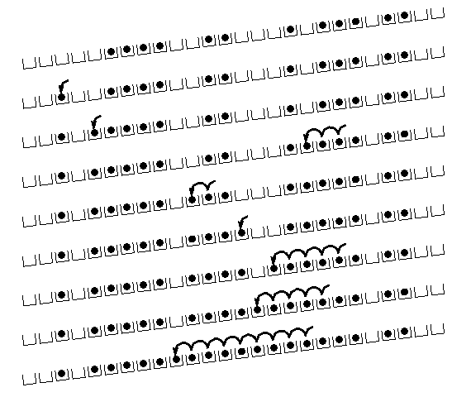
Linear Probing – Clustering
no collision
collision in small cluster
no collision
collision in large cluster
[R. Sedgewick]
Primary Clustering.
Nodes hash to same key clump.
Nodes hash to same area clump.
Notes:
You can see that this works pretty well for an empty table and gets worse as the table fills up.
There’s another problem here. If a bunch of elements hash to the same spot, they mess each other up.
But, worse, if a bunch of elements hash to the same area of the table, they mess each other up! (Even though the hash function isn’t producing lots of collisions!)
This phenomenon is called primary clustering.

Slide 326
Load Factor in Linear Probing
Math complex b/c of clustering
For any λ < 1, linear probing will find an empty slot
Expected # of probes (for large table sizes)
  successful search:
  unsuccessful search:
Linear probing suffers from primary clustering
Performance quickly degrades for λ > 1/2
Probes = 2.5 for λ = 0.5
Probes = 50.5 for λ = 0.9
Also insertions
Keep
lambda < 1/2
Book has nice graph of this p. 179
Notes:
There’s some really nasty math that shows that (because of things like primary clustering), each successful search w/linear probing costs…
That’s 2.5 probes per unsuccessful search for lambda = 0.5.
50.5 comparisons for lambda = 0.9
We don’t want to let lambda get above 1/2 for linear probing.

Slide 327
Quadratic Probing
Less likely to encounter Primary Clustering
f(i) = i²
Probe sequence:
  0th probe = h(k) mod TableSize
  1th probe = (h(k) + 1) mod TableSize
  2th probe = (h(k) + 4) mod TableSize
  3th probe = (h(k) + 9) mod TableSize
  . . .
  i^{th} probe = (h(k) + i²) mod TableSize
f(i+1) = f(i) + 2i + 1
Notes:
Add a function of I to the original hash value to resolve the collision.
Less likely to encounter primary clustering, but could run into secondary clustering.
Although keys that hash to the same initial location will still use the same sequence of probes (and conflict with each other).
How big to make hash table? Lambda = ½, (hash table is twice as big as the number of elements expected.)
Note: (i +1)² – i² = 2i + 1 Thus, to get to the NEXT step, you can add 2* current value of i plus one.

Slide 328
Quadratic Probing
0
1
2
3
4
5
6
7
8
9
Insert:
89
18
49
58
79

Slide 329
Quadratic Probing Example
insert(76)
76%7 = 6
insert(40)
40%7 = 5
insert(48)
48%7 = 6
insert(5)
5%7 = 5
insert(55)
55%7 = 6
0
48
1
insert(47)
47%7 = 5
But…
2
5
0: 5
1: 6
4: 2
9: 0
16: 0
25: 2
Never finds spot!
3
55
4
5
40
6
76
Notes:
And, it works reasonably well.
Here it does fine until the table is more than half full.
Let’s take a closer look at what happens when the table is half full.

Slide 330
Quadratic Probing:
Success guarantee for λ < ½
First size/2 probes
distinct. If < half full,
one is empty.
If size is prime and λ < ½, then quadratic probing will find an empty slot in size/2 probes or fewer.
  show for all 0 ≤ i,j ≤ size/2 and i ≠ j
  (h(x) + i²) mod size ≠ (h(x) + j²) mod size
  by contradiction: suppose that for some i ≠ j:
  (h(x) + i²) mod size = (h(x) + j²) mod size
  ⇒ i² mod size = j² mod size
  ⇒ (i² - j²) mod size = 0
  ⇒ [(i + j)(i - j)] mod size = 0
  Because size is prime(i-j)or (i+j) must be zero, and neither can be
Notes:
Well, we can guarantee that this succeeds for loads under 1/2.
And, in fact, for large tables it _usually_ succeeds as long as we’re not close to 1.
But, it’s not guaranteed!

Slide 331
Quadratic Probing: Properties
For any λ < ½, quadratic probing will find an empty slot; for bigger λ, quadratic probing may find a slot
Quadratic probing does not suffer from primary clustering: keys hashing to the same area are not bad
But what about keys that hash to the same spot?
  Secondary Clustering!
Secondary clustering.
Not obvious from looking at table.
Notes:
At lambda = 1/2 about 1.5 probes per successful search
That’s actually pretty close to perfect… but there are two problems.
First, we might fail if the load factor is above 1/2.
Second, quadratic probing still suffers from secondary clustering. That’s where multiple keys hashed to the same spot all follow the same probe sequence.
How can we solve that?

Slide 332
Double Hashing
f(i) = i * g(k)
where g is a second hash function
Probe sequence:
  0th probe = h(k) mod TableSize
  1th probe = (h(k) + g(k)) mod TableSize
  2th probe = (h(k) + 2*g(k)) mod TableSize
  3th probe = (h(k) + 3*g(k)) mod TableSize
  . . .
  i^{th} probe = (h(k) + i*g(k)) mod TableSize
Notes:
So the probe sequence is a function of the key in two different ways – for the original starting location (h(k) AND for the amount of offset you move out each time you have a collision (g(k)). (as opposed to both linear probing and quadratic probing where the offset is independent of the key)
** In choosing g care must be taken so that it never evaluates to 0.
A good choice for g is to choose a prime R < TableSIze and let g(k) = R – (k mod R).
Double Hashing is Safe for λ < 1

Slide 333
Double Hashing Example
h(k) = k mod 7 and g(k) = 5 – (k mod 5)
76
93
40
47
10
55
0
0
0
0
0
0
1
1
1
1
47
1
47
1
47
2
2
93
2
93
2
93
2
93
2
93
3
3
3
3
3
10
3
10
4
4
4
4
4
4
55
5
5
5
40
5
40
5
40
5
40
6
76
6
76
6
76
6
76
6
76
6
76
Probes 1 1 1 2 1 2

Slide 334
Resolving Collisions with Double Hashing
0
1
2
3
4
5
6
7
8
9
Hash Functions:
H(K) = K mod M
H₂(K) = 1 + ((K/M) mod (M-1))
M =
Insert these values into the hash table in this order. Resolve any collisions with double hashing:
13
28
33
147
43

Slide 335
Rehashing
Idea: When the table gets too full, create a bigger table (usually 2x as large) and hash all the items from the original table into the new table.
When to rehash?
  half full (λ = 0.5)
  when an insertion fails
  some other threshold
Cost of rehashing?
Notes:
Go through old hash table, ignoring items marked deleted
Recompute hash value for each non-deleted key and put the item in new position in new table
Cannot just copy data from old table because the bigger table has a new hash function
Running time?? O(N) – but infrequent. But Not good for real-time safety critical applications

Slide 336
Java hashCode() Method
Class Object defines a hashCode method
  Intent: returns a suitable hashcode for the object
  Result is arbitrary int; must scale to fit a hash table (e.g. obj.hashCode() % nBuckets)
  Used by collection classes like HashMap
Classes should override with calculation appropriate for instances of the class
  Calculation should involve semantically “significant” fields of objects

Slide 337
hashCode() and equals()
To work right, particularly with collection classes like HashMap, hashCode() and equals() must obey this rule:
if a.equals(b) then it must be true that
a.hashCode() == b.hashCode()
  Why?
Reverse is not required

